Slide 1

Lesson 9
Reducibility
Theory of Computation
王轩
Wang Xuan

Slide 2
Reducibility
Introduction
Undecidable Problems from Language Theory
Computation history method

Slide 3
Reducibility
Introduction
Undecidable Problems from Language Theory
Computation history method

Slide 4



Reducibility
Problem is reduced to problem
If we can solve problem
then we can solve problem

Slide 5


Theorem:
If: a: Language is reduced to
b: Language is undecidable
Then: is undecidable
Proof:
Suppose is decidable
Using the decider for
build the decider for
Contradiction!

Slide 6


Observation:
In order to prove
that some language is undecidable
we only need to reduce a
known undecidable language
to

Slide 7

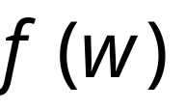

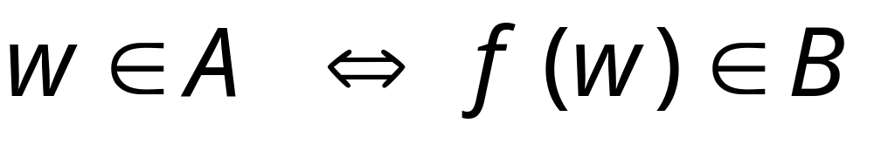
If is decidable then we can build:
Decider for
Reduction
Input
string
YES
accept
YES
accept
compute
Decider
for
(halt)
(halt)
NO
reject
NO
reject
(halt)
(halt)
CONTRADICTION!
END OF PROOF

Slide 8
Reducibility
Introduction
Undecidable Problems from Language Theory
Computation history method

Slide 9
HALT_{TM} is undecidable
HALT_{TM} = {<M,w> | M is a TM and M halts on input w}
Idea: Proof by contradiction.
  Assume HALT_{TM} is decidable.
  Prove that A_{TM} is reducible to HALT_{TM} . (important)
  Because A_{TM} is undecidable. Contradiction.

Slide 10
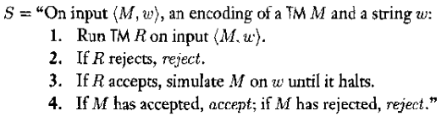
Proof
TM R decides HALT_{TM}. We construct TM S to decide A_{TM}.
Because A_{TM} is undecidable, HALT_{TM} must be undecidable.

Slide 11
TM S decides A_{TM}, R decides HALT_{TM}.
S
R
R rejects w
reject
M,w
M
accept
accept
R accepts w
reject
reject

Slide 12
E_{TM} is undecidable
E_{TM} = {<M,w> | M is a TM and L(M)=φ}
Idea: Proof by contradiction. (Same)
  Assume E_{TM} is decidable.
  Prove that A_{TM} is reducible to E_{TM} .
  Because A_{TM} is undecidable. Contradiction.

Slide 13
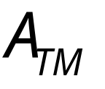
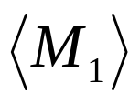
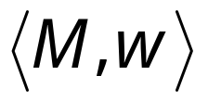
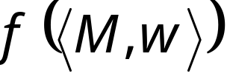
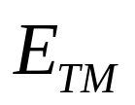

Decider for
Reduction
YES
Compute
Decider
NO
NO
Yes
Given the reduction,
if is decidable,
then is decidable
A contradiction!
since
is undecidable

Slide 14
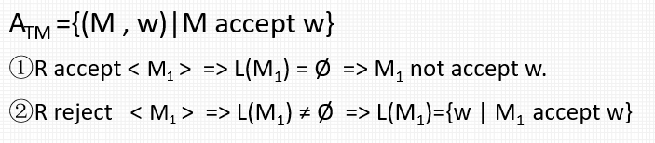

Proof
TM R decides E_{TM}. We construct TM S to decide A_{TM}.
Run R on input <M>
  Accept. L(M) is empty. M does not accept any string.
  Reject. L(M) is not empty. But do not know what L(M) is.
Run R on a modification of <M>, call it M₁
  To reject all strings except w, but on w it works as usual
  Use R to determine whether M₁ recognizes the empty language

Slide 15
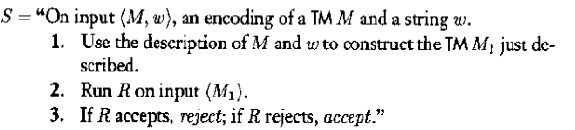
Run R on input <M,w>
  M does not accept any string, including w (L(M)= φ). L(M) is empty. Accept.
  M accepts w (L(M)=w). Reject.
Construct TM S that decides A_{TM}.
Contradiction

Slide 16
REGULAR_{TM} is undecidable
REGULAR_{TM} = {<M>|M is a TM and L(M) is a regular language}
Similar as E_{TM}
Construct modified machine M₂ to recognize {0^{n}1^{n}|n≥0} if M doesn’t accept w, and to recognize regular language if M accepts w.

Slide 17
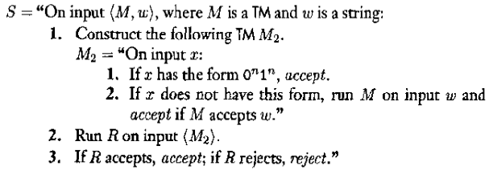
Proof
Let R be a TM that decides REGULAR_{TM} and construct TM S to decide A_{TM}.
S works in the following manner:

Slide 18
Rice’s theorem
CFG_{TM} = {<M>|M is a TM and L(M) is a context-free language} is undecidable
Generally, Rice’s theorem
Testing any property of the languages recognized by Turing machines if undecidable.

Slide 19
A_{TM}
  Reduce A_{TM} to E_{TM}
  Reduce A_{TM} to REGULAR_{TM}
Thus we can use E_{TM} , REGULAR_{TM} for other problems
  An example: Reduce E_{TM} to EQ_{TM}
EQ_{TM} = {<M₁,M₂> | M₁ and M₂ are TMs and L(M₁)=L(M₂)}

Slide 20
Idea
E_{TM} : the language of a TM is emtpy
EQ_{TM} : the languages of two TMs are the same
For EQ_{TM}, if one of these languages is φ, the language of another machine is empty- E_{TM} .
In a sense, E_{TM} is a special problem of EQ_{TM} wherein one of the machines recognize the empty language.

Slide 21
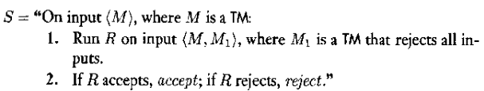
Proof
Let TM R decide EQ_{TM} and construct TM S to decide E_{TM} as follow.
If R decides EQ_{TM} , S decides E_{TM} .
Thus EQ_{TM} is undecidable.

Slide 22
Reducibility
Introduction
Undecidable Problems from Language Theory
Computation history method

Slide 23
Computation history method
The computation history for a Turing machine on an input is simply the sequence of configurations that the machine goes through as it processes the input.

Slide 24
An accepting computation history for TM M on input w is a sequence of configurations C₁,C₂,…,C_{l}
  C₁ is the start configuration of M on w,
  C_{l} is an accepting configuration of M
  Each C_{i} legally follows from C_{i-1} according to rules of M
A rejecting computation history for M on w is defined similarly, except that C_{l} is a rejecting configuration.
Computation Histories are finite sequences.

Slide 25
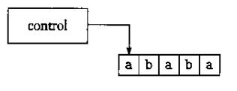
Linear bounded automation LBA
LBA is a restricted type of TM.
  Tape head is limited in the portion of the tape containing the tape.
  If it tries to move its head off either end of the input, stays where it is.

Slide 26
Power of LBA
LBA s are quite powerful
  Deciders for A_{DFA}, A_{CFG}, E_{DFA}, and E_{CFG} all are LBAs.
  Every CFL can be decided by an LBA.
A_{LBA}={<M,w>|M is an LBA that accept string w}
Prove A_{LBA} is decidable.

Slide 27
Lemma
Let M be an LBA with q states and g symbols in the tape alphabet. There are exactly qng^{n} distinct configurations of M for a tape of length n.
Proof
  A configuration contains
    the state of the control (q states),
    position of the head (n positions),
    contents of the tape (g^{n} possible strings of tape symbol).
  The product of these three quantities is the total number of different configurations.

Slide 28
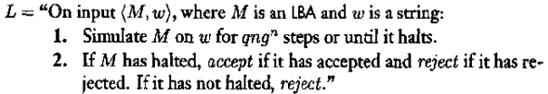
A_{LBA} is decidable
Idea
  If M halts, ok
  If M loops: how to detect
    Number of configuration is finite
Proof: the algorithm that decides A_{LBA} is as follows.

Slide 29
E_{LBA} is undecidable
E_{LBA}={<M>|M is an LBA and L(M)= φ}
Idea: how to construct TM S to decide A_{TM}
  For a TM M and an input w, determine whether M accept w by construct a LBA B and testing whether L(B) is empty
  L(B) comprises all accepting computation histories for M on w
    If M accepts w <=> exist a accepting computation history for M on w <=> L(B) is not empty
    If M doesn’t accept w <=> not exist a accepting computation history for M on w <=> L(B) is empty
  Such, if we decide whether L(B) is empty, we determine whether M accepts w => A_{TM} is decidable. Contradiction!

Slide 30

IDEA: Construct LBA B
Construct B for M and w using computation histories.
B={ x| x is an accepting computation history for M on w}
An accepting computation history x is the sequence C₁,C₂,…,C_{l} that M goes through as it accepts some string w.
Why B is a LBA?
M accepts w => M stops on accepting states within finite steps => The length of x is finite => B is a LBA.

Slide 31
IDEA:LBA B works
When B receives an input x, B is supposed to accept if x is an accepting computation history for M on w.
  First, B breaks up x into strings C₁, C₂,…, C_{l}.
  Then B determine whether C_{i} satisfy the three conditions of an accepting computation history:
    C₁ is the start configuration for M on w.
    Each C_{i+1} legally follows from C_{i}.
    C_{l} is an accepting configuration for M.

Slide 32
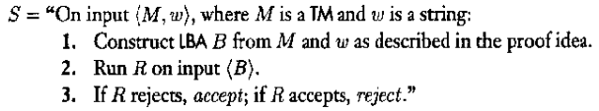
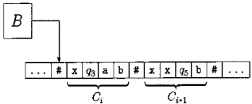
Proof
Suppose that TM R decides E_{LBA}. Construct TM S that decides A_{TM} as follows.
  If R accepts <B> => <B>∈ E_{LBA} => B is a LBA, and L(B)=φ => M has no accepting computation history on w => M doesn’t accept w => S rejects <M,w>.
  If R rejects <B> => <B>∉E_{LBA} => L(B) ≠ φ or B is not a LBA(as we have proved B is a LBA) => L(B) ≠ φ => there is at least one an accepting computation history for M on w. => M accept w. => S accepts <M,w>.
  S is a decider for A_{TM}. Contradiction!

Slide 33
ALL_{CFG} is undecidable
ALL_{CFG} ={<G>|G is a CFG and L(G)=Σ*}.
For a TM M and an input w, we construct a CFG G that generates all strings if and only if M does not accept w.
If M does accept w, G doesn’t generate the accepting computation history for M on w.
G is designed to generate all strings that not accepting computation histories for M on w.

Slide 34

Make CFG G generate all strings that fail to be an accepting computation history for M on w, follow the strategy
  An accepting computation history for M on w appears as
  Then , G generates all strings that
If M doesn’t accept w, no accepting computation history exists, so all strings fail in one way or another. Therefore G would generate all string, as desired.

Slide 35
Reducibility
Introduction
Undecidable Problems from Language Theory
Computation history method

